Slide 1
Personnel Development Program Data Collection System (PDPDCS)
Tracie Dickson, OSEP
Celia Rosenquist, OSEP
Michelle Bloom (AnLar), Program Coordinator
Emily Hare (Westat), Program Coordinator Support
December 15, 2025

Slide 2
Purpose of New Grantees Training
Orient new grantees to data reporting requirements
Improve the quality of data submitted by grantees and scholars
Introduce the PDP Data Collection System (PDPDCS)

Slide 3
Training Agenda
325D, 325K, and 325M grant priorities and requirements
Grantee reporting and evaluation
Using the PDPDCS
Data entry and collection requirements
Service obligation requirements
Strategies for avoiding security incidents
Resources and support

Slide 4
PDPDCS Data Submission Process
OSEP
awards grant
Grantee recruits and selects scholars
Grantee assures that scholars meet regulatory requirements before receiving federal funds
Grantee provides scholarship assistance and grantee/scholar sign and submit Pre-Scholarship Agreement
Grantee updates and submits scholar data
Scholar fulfills obligation through service
Scholar exits program and grantee/scholar sign and submit Exit Certification
Scholar elects cash repayment or is not
in compliance
Scholar must submit eligible employment
Scholar referred for cash repayment
Employer must verify employment
4

Slide 5
Grant Priorities and Requirements

Slide 6
FY 2025 325D, 325K, 325M Priorities
Preparation of Special Education and Early Intervention Administrators (325D)
  Ph.D. or Ed.D. programs
Interdisciplinary Preparation… for Children with Disabilities who have High-Intensity Needs (325K)
  M.A./M.S., Ed.S., or Clinical doctoral programs
  Educational interpreters for the deaf bachelor’s degree programs
Personnel Preparation of Special Education, Early Intervention, and Related Services Personnel at IHEs, HBCUs, TCCUs, and other MSIs (325M)
  B.A./B.S., Cert., M.A./M.S., Ed.S., or Clinical doctoral programs

Slide 7

Scholar Service Obligation
Individuals who receive scholarship assistance (scholars) from projects are required to complete a service obligation or repay all or part of the cost of such assistance, in accordance with section 662(h) of the Act and the regulations of this part.
Consistent with 34 CFR 304.30, each scholar must
  Receive support for no less than one academic year, and
  Be eligible to fulfill service obligation requirements following degree program completion.

Slide 8

Service Obligation Requirements
Scholars must complete at least one full-time academic year of training before they may begin to fulfill their service obligation
  Scholars must complete the full-time equivalent of one full academic year if the scholar is part-time
  Scholars may complete less than one academic year if the
  entirety of the OSEP-funded program is less than a year
Requirements for employment to be deemed eligible:
  Paid position, not funded by an OSEP grant program
  Cannot be part of an internship, practicum, or other work-related requirement of the scholar’s completion of the preparation program

Slide 9
Service Obligation Requirements – continued
Direct Service:
  At least 51% of the infants, toddlers, and children to whom the individual provides services are receiving special education, related services, or early intervention services from the individual; or
  The individual spends at least 51% of their time providing special education, related services, or early intervention services to infants, toddlers, and children with disabilities.
Indirect Service:
  If the position involves supervision including in the capacity of a principal, teaching at the postsecondary level, research, policy, technical assistance, program development, or administration, the individual spends at least 51% of their time performing work related to the scholarship training.

Slide 10

Scholar Recruitment and Enrollment
Recruitment strategies and selection criteria must ensure equal access and treatment of all applicants seeking admission to the program and must be consistent with applicable law, including Federal civil rights law.
Recruit and enroll scholars within the first 12 months of the project
Scholars enrolled after first 12 months must be able to complete on time
Obtain approval from your project officer and submit a revised project budget if there are changes in the proposed number of scholars

Slide 11
Grantee Requirements Related to Scholar Enrollment
§ 304.22 Requirements for grantees in disbursing scholarship
(a) Ensure that the scholar (1) Is a citizen or national of the United States. (2) Is a permanent resident of (i) Puerto Rico, United States Virgin Islands, Guam, American Samoa, or the Commonwealth of the Northern Mariana Islands; or (ii) The Republic of the Marshall Islands, the Federated States of Micronesia, or the Republic of Palau during the period in which these entities are eligible to receive an award under the Personnel Development to Improve Services and Results for Children with Disabilities program; or (3) Provides evidence for the U.S. Department of Homeland Security that the individual is (i) A lawful permanent resident of the United States; or (ii) In the United States for other than a temporary purpose with the intention of becoming a citizen or permanent resident;

Slide 12
Grantee Requirements Related to Scholar Enrollment continued:
(b) Limit the cost of attendance portion of the scholarship assistance (as discussed § 304.21 (a)) to the amount by which the individuals cost of attendance at the institution exceeds the amount of the grant assistance the scholar is to receive for the same academic year under title IV of the HEA;
(c) Obtain a Certification of Eligibility for Federal Assistance from each scholar, as prescribed in 34 CFR 75.60, 75.61, and 75.62.

Slide 13

Scholar Funding
Funding does not need to be uniform for all enrolled scholars, but may include:
  Tuition and fees
  IHE student health insurance
  Books, materials, and supplies
  Misc. personal expenses
  Dependent or childcare
  Room and board
  Travel and conference registration
  Stipends to support scholars’ completion

Slide 14
Grantee Reporting and Evaluation

Slide 15
PDP Performance Measures Purpose
Helps measure whether the PDP is meeting its objectives
Demonstrates program progress and effectiveness over time
Used by Congress to determine future program funding
Required under the Government Performance and Results Act (GPRA)

Slide 16

PDP Government Performance and Results Act (GPRA) Measures
Sources of Data:
  Grantee enters data in PDPDCS for each scholar receiving OSEP support under this grant at the following times:
    Scholar’s enrollment,
    Annually during the Data Collection Period, and
    Graduation or Exit
  Scholar enters employment information
  Employer(s) verify employment

Slide 17

PDP PROGRAM Performance Measure 1
The percentage of preparation programs that incorporate evidence-based practices into their curricula.
Source of data: Panel with expertise in personnel preparation will review syllabi from PDP grantees one year following the grant award.
  Syllabi from FY 2025 grants will be
  reviewed & results reported in FY 2026
  Syllabi submitted in application AND new or
  revised syllabi submitted to OSEP will be used
  More information will follow in Year 1

Slide 18

Evidence-Based Practice Areas
325D syllabi must demonstrate building competencies in:
  Research methods,
  Evaluation methods, or
  Data analysis courses required by the degree program.
325M and 325K syllabi must demonstrate building competencies in:
  Assessment;
  Inclusive practices as defined in IDEA;
  Instructional strategies; and
  Literacy and math, if appropriate.

Slide 19
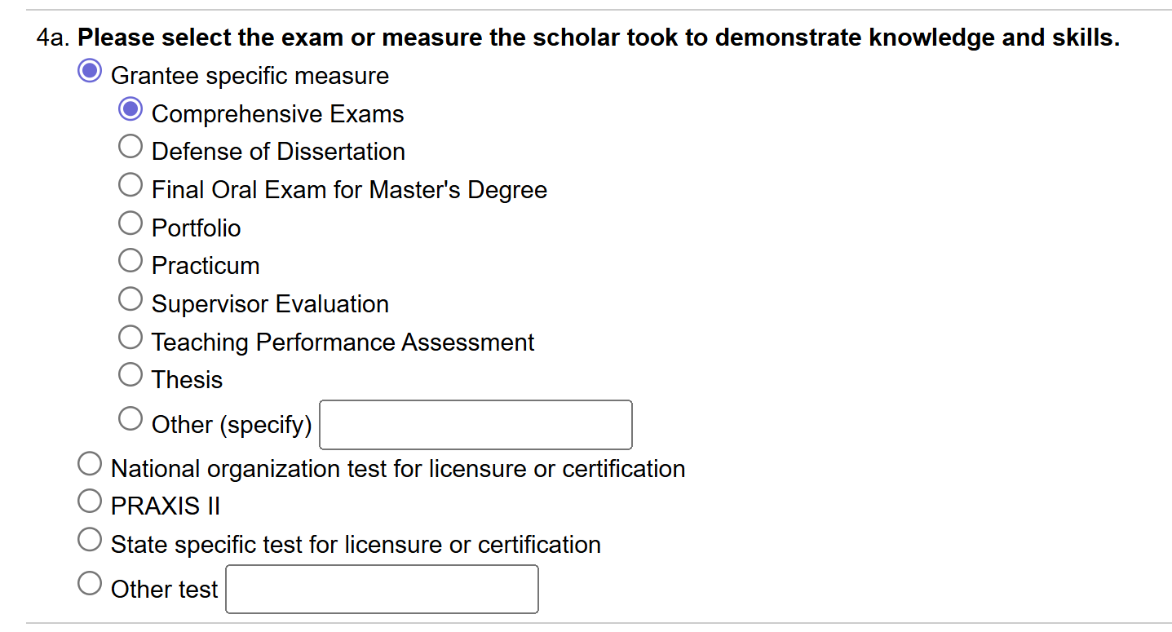
PDP PROGRAM Performance Measure 2
The percentage of scholars completing preparation programs who are knowledgeable and skilled in evidence-based practices (EBPs) for children with disabilities.
Source of Data: Grantees must include at least one measure to demonstrate each completed/ graduated scholar is “knowledgeable and skilled in use of EBPs” for children with disabilities.

Slide 20
PDP PROGRAM Performance Measures 3 - 6
The percentage of scholars who exit preparation program prior to completion due to poor academic performance.
The percentage of scholars completing preparation programs who are working in the area(s) for which they were prepared upon program completion.
The Federal cost per scholar who completed the preparation program.
The percentage of scholars who completed the preparation program and are employed in high-need districts.

Slide 21
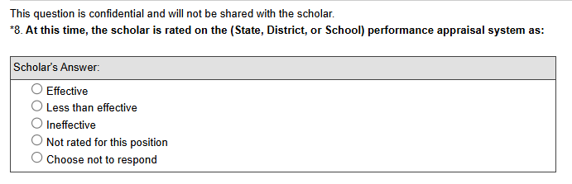
PDP PROGRAM Performance Measure 7
The percentage of scholars who completed the preparation program and are rated effective by their employers.
Sources of data:
  Scholars who completed their program and submitted an employment record
  Employers rating the scholar’s effectiveness in the verification form

Slide 22

PDP PROGRAM Pilot Outcome Measures
The number and percentage of scholars proposed by the grantee in their application that were enrolled and making satisfactory academic progress in the current academic year.
The number and percentage of enrolled scholars who are on track to complete the training program by the end of the project's original grant period.
The percentage of scholars who completed the
preparation program and are employed in the
field of special education for at least two years.

Slide 23
Grant Performance Reports
Annual Performance Reports (APR)
  OSEP will send instructions for preparing and submitting APRs to grantees before February 1 annually
  Deadline for submission is COB on the first Friday in May (4:30 pm ET)
Final Performance Report
  Deadline for submission is 90 days after grant end date
Include scholar accomplishments
Both are submitted in G5

Slide 24
Using the PDPDCS

Slide 25
Secondary Users
Project Directors are responsible for data entry; however, secondary users may to assist with this process.
Secondary users:
  Can enter scholar information, and
  Have a unique login.
Only three people per grant may access.
  Project Directors may change the secondary user(s) at any time.
Note: You may NOT create a shared
inbox for your secondary user(s) –
each user requires a unique login.

Slide 26
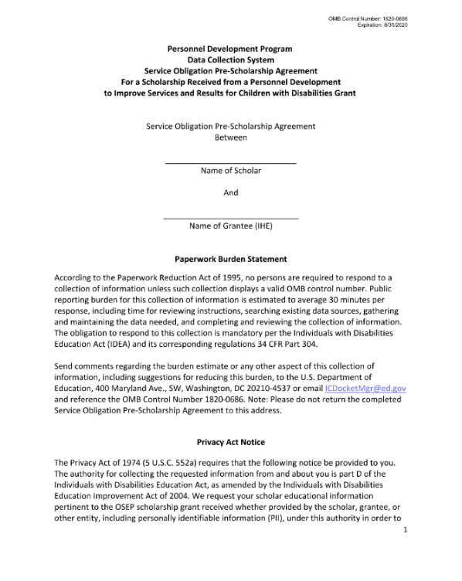
Pre-Scholarship Agreement (PSA)
What is it?
Tips for Helping Scholars
Legally binding form signed by the grantee and scholar
Explains the terms and conditions of PDP, including service obligation
Should be completed before the scholar receives funding
Must uploaded or submit a unique PSA in PDPDCS for
each scholar
Meet with scholars individually or in small groups to explain requirements in detail
Ask scholars to go through the PSA with their parents/guardians
Invite a recent graduate to speak to scholars about the requirements

Slide 27
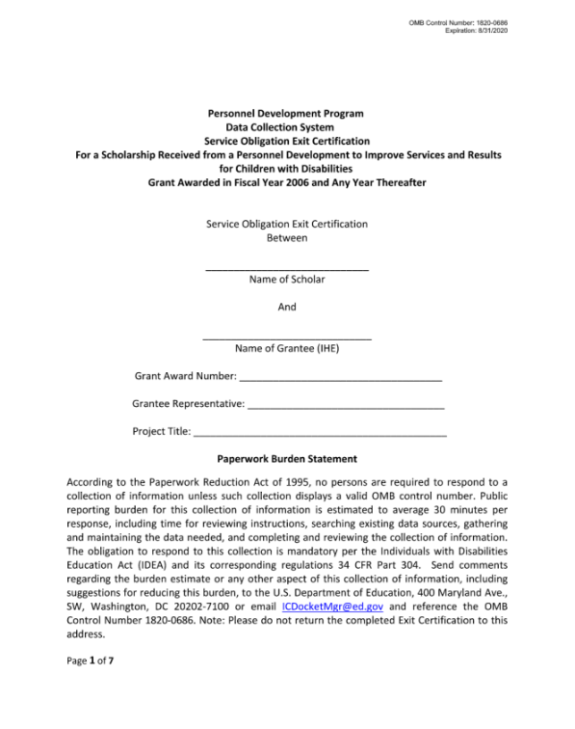
Exit Certification (EC)
All scholars and grantees must sign the legally binding form.
Grantees must retain all grant records until each scholar’s service obligation has been fulfilled or paid back.
Grantees may be held responsible for funds provided to scholars with missing or invalid documents.

Slide 28

Issues with PDF Upload PSAs
Missing or invalid project director signature
Missing or invalid scholar signature
Missing grant information
Missing pages
Uploaded to the incorrect
scholar record
Valid signatures must be:
Signed in ink or
Signed with a legal digital signature software (e.g., Docusign, Adobe Acrobat), and
In PDF format (not Word).

Slide 29
PDPDCS: Live Demonstration
PDPDCS demonstration will show:
  Locating FAQs and resources
  Logging into the system
  Updating grant and contact information
  Adding a secondary user
  Using the digital Pre-Scholarship Agreement (PSA)
  Creating a scholar record
  Updating scholar data

Slide 30
Data Entry and Collection Requirements

Slide 31


Submitting Scholar Records
Once a scholar record is submitted by the grantee, scholars can access the PDPDCS to:
  Confirm contact information
  Review training information
  View service obligation status
  Enter eligible employment information to fulfill their service obligation
Scholar records cannot be “pending” for more than 30 days

Slide 32
Exiting Scholars
Step 1: Ensure all information in Sections A – I is accurate
Step 2: Complete digital EC or upload PDF EC
Step 3: Enter scholar exit information
(Sect. J) if applicable
Step 4: Save and Submit scholar record

Slide 33
PDPDCS Reporting:
Timely Submission
Submit all data on time (APR, PDPDCS, and FPR).
  According to 34 CFR 75.253(a)(3), the timely submission of this report is one of the factors that the Secretary will consider in determining whether to continue your project's funding for next fiscal year.
  According to section 75.217(d)(3)(ii), the Secretary can consider the failure to submit scholar data in a timely fashion in determining your project’s ability to obtain future grants from the Office of Special Education Programs or under any other Department program.

Slide 34
Fulfilling Service Obligation

Slide 35

Scholars’ Employment Record
Information collected includes:
  Contact information for Supervisor and/or HR Manager
  Type of organization
  Dates of employment
  Type of position (e.g., teacher, therapist)
  Full- or part-time hours
  Primary and secondary training area(s)
  Disability category(s) of children served
  Whether the position meets PDPDCS time requirements
  Certification or licensure for the position

Slide 36
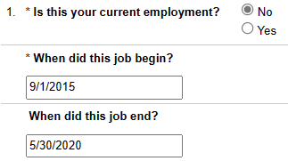
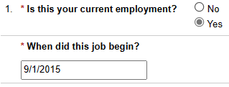
Service Obligation Calculator
Previous Employment
Current Employment

Slide 37

Employer Submission Requirements
Employers verify employment information within the PDPDCS
  Scholars do not receive credit for service obligation until the employer has verified their employment
  Scholars receive an email when their employment is verified or disputed
Employers must verify each time scholar submits their employment record (every 6 months)

Slide 38
Avoiding Security Incidents

Slide 39

Security Incidents
A security incident occurs if personally identifiable information (PII) is potentially viewable to unrelated parties.
Examples from PDPDCS:
  Uploading an unredacted Pre-Scholarship Agreement (PSA) PDF to the wrong scholar record
  Sending unencrypted documents
  (Social Security Card, Driver’s
  License, etc.) in an email to the
  PDPDCS Help Desk

Slide 40
Impacts of Security Incidents on Department Staff
PDPDCS staff must notify the Department’s Education Security Operation Center (EDSOC), document the incident, and expunge the file or email from the servers
Additional interviews, investigations, and mitigation strategies may be necessary
PDPDCS Staff must review all other scholar records and documentation associated with the grantee

Slide 41
Impacts of Security Incidents on Grantees
Grantees must resubmit scholar documentation, complete security incident report, and participate in investigation interviews as needed.
Project Directors and Secondary Users will be required to participate in a security training to understand the proper handling of scholar PII and the consequences of data breaches.
The grant will be placed on a security incident list tracked by PDPDCS and OSEP staff. If further incidents occur, the grant and university could be placed on high-risk status, impacting their ability to receive future federal funding.

Slide 42
How to Avoid Security Incidents
Always encrypt files being sent by email, including to the PDPDCS Help Desk.
Use the digital Pre-Scholarship Agreements and Exit Certifications to avoid uploading a document to the wrong scholar record.
Implement a file naming convention to track files associated with each scholar’s record: PSA_J_DOE.pdf.

Slide 43
Resources and Support

Slide 44

Always Read System Emails
Notifications regarding system or policy
changes as well as data submission
reminders are sent via email.
  Add serviceobligation@ed.gov to your contact list
  Check your email settings to be sure emails from this account are not marked as spam

Slide 45

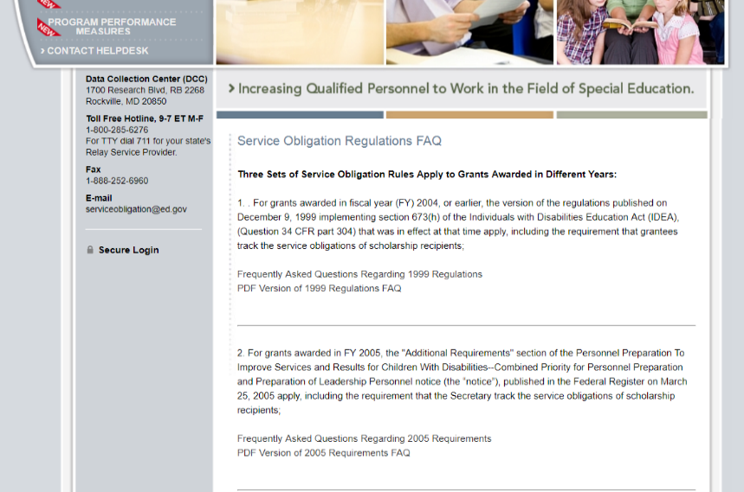
PDPDCS Website Resources
PDPDCS resources include:
  A closed-captioned recording of this webinar will be made available (https://pdp.ed.gov/OSEP/Home/Training).
  PDPDCS Frequently
  Asked Questions
  (https://pdp.ed.gov/
  OSEP/Home/dcsfaq).

Slide 46
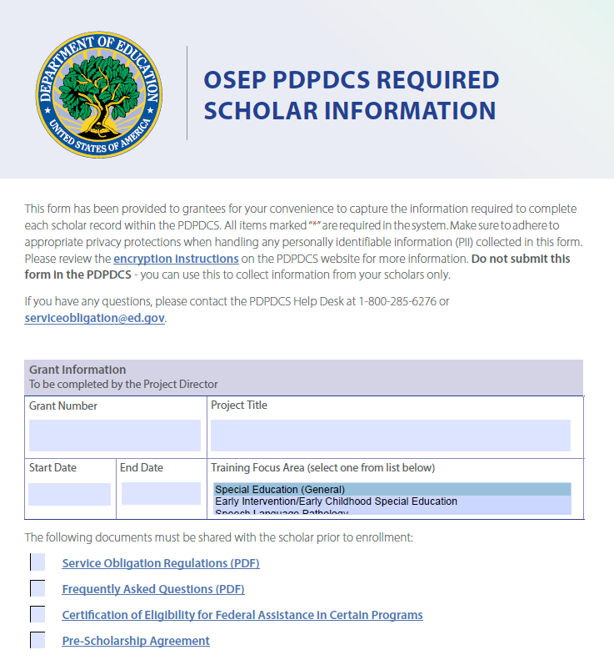
Required Scholar Information
Reference document to assist grantees with collecting information from scholars
Not to be submitted into PDPDCS
Adhere to privacy protections

Slide 47
Support Using PDPDCS: Help Desk
The PDPDCS Help Desk is available by phone or email to answer questions you or your scholars may have regarding the PDPDCS. Help Desk support is available:
  Monday through Friday from 8 am to 8 pm, ET
  Email: serviceobligation@ed.gov
  Toll Free Hotline: 1-800-285-6276
  If someone is not available when you call, please leave a message. A Help Desk operator will return your message within one business day.
A designated specialist can also spend additional time walking you through components of the PDPDCS. Just contact the Help Desk to set up an appointment.

Slide 48
Questions and Discussion
We want your feedback! Please respond to the SurveyMonkey poll.
More questions?
PDPDCS Help Desk
  Support available from 8 am to 8 pm EST
  Monday through Friday
  1-800-285-6276
  serviceobligation@ed.gov

